Slide 1
Introduction to database

Slide 2
mongo DB
What is MONGODB ?
MongoDB is widely used for storing product information and details by finance and e-commerce companies.
It is also known for its horizontal scaling and load balancing capabilities, which has given application developers an unprecedented level of flexibility and scalability.
MongoDB Features
Ad-hoc queries for optimized, real-time analytics
Indexing appropriately for better query executions
Replication for better data availability and stability
Load balancing

Slide 3
SQL
What is SQL ?
Structured query language (SQL) is a programming language for storing and processing information in a relational database. A relational database stores information in tabular form, with rows and columns representing different data attributes and the various relationships between the data values.
Features of SQL
Data Definition Language(DDL): SQL provides many commands, one of which is Data Definition Language(DDL)
Data Manipulation Language(DML)
Relational Foundation
High-performance
Scalability
Security and authentication

Slide 4
NoSQL
What is NOSQL ?
NoSQL Database is a non-relational Data Management System, that does not require a fixed schema. It avoids joins, and is easy to scale.
The key features of NoSQL databases are:
Multiple data model compatibility. Relational databases usually require data to be placed in table form before they can access and analyze it
Enhanced scalability and availability. Relational databases are undoubtedly scalable
Global data distribution
Minimal downtime

Slide 5
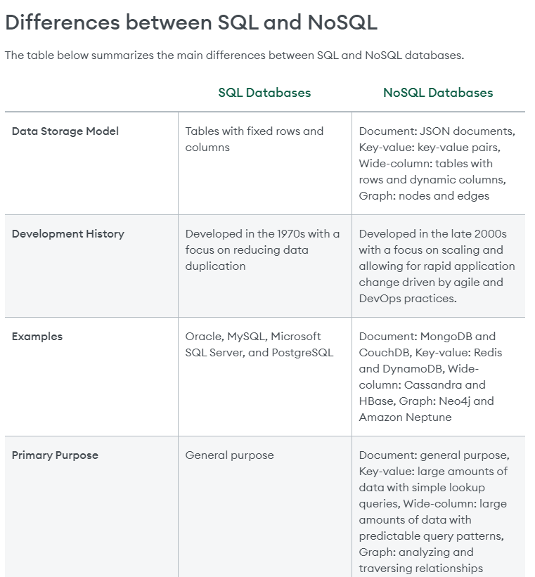
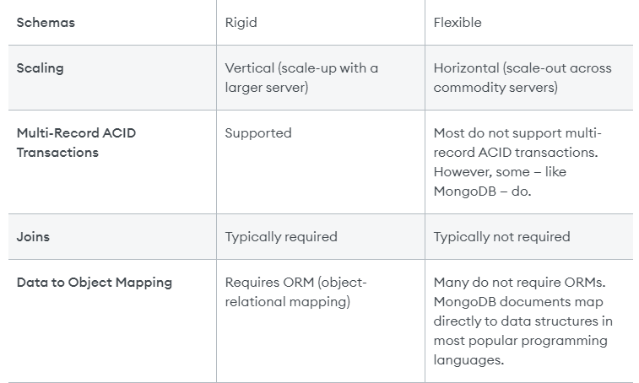

Slide 6
